Slide 1

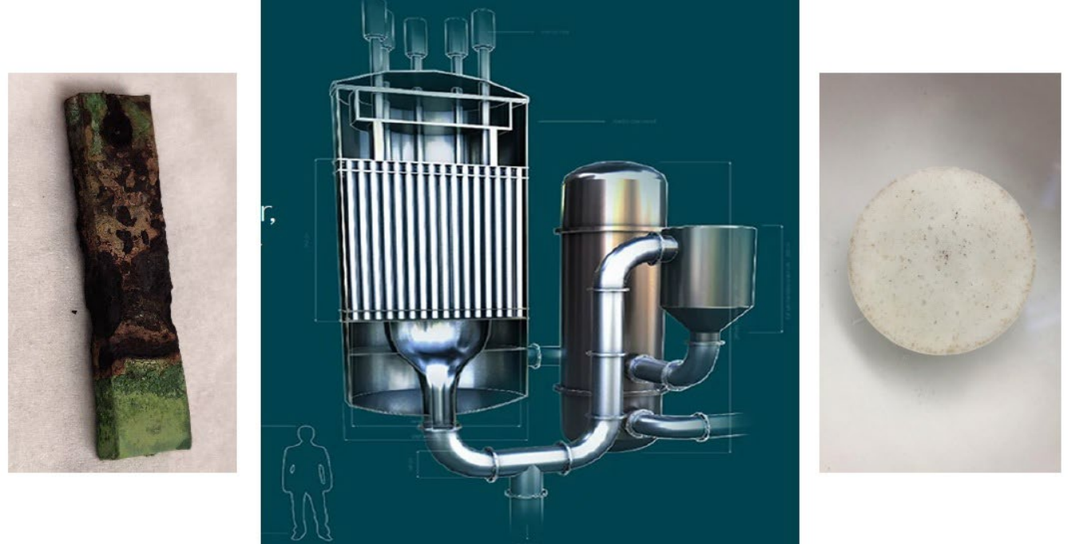
MATERIALS AND SURFACE ENGINEERING
DEPARTMENT OF CIVIL AND MECHANICAL ENGINEERING
PROJECT LEVEL: Master and Bachelor
Corrosion in Molten Salt
SUPERVISORS
Morten S. Jellesen
msje@dtu.dk,
John Hald
jhald@dtu.dk,
Birgitte Stoffersen
birst@dtu.dk,
[INSERT PROJECT IMAGE]
COLLABORATION
Molten Salt companies as Copenhagen Atomics, Seaborg Technologies or Nordic Salt Cycle
01 / PROJECT BACKGROUND
Molten salt technologies offers new promising qualities, like excellent heat transfer properties or inherent safety arising from high thermal stability and low pressures. The disadvantage of molten salt lies in their high corrosivity, which makes their long-term containment challenging. Nickel alloys and nickel surface treatments are the most promising solutions; however, further development is necessary.
02 / PROJECT AIM
[The scope of this master thesis project is to investigate the corrosion resistance in molten salt, e.g.
Characterize samples in SEM/EDS and optical microscope.
Conduct corrosion tests in molten fluorides at high temperatures.
Investigate corrosion resistance in SEM/EDS and optical microscope.
Make recommendations about critical values and further work.
03 / PROJECT ACTIVITIES
All the projects involve literature study, experimental exposure tests, preparation of samples for characterization by SEM and XRD, determination of the nature of the corrosion and corrosion rates
04 / PRACTICAL NOTES
The exact topic and nature of the project will be specified in a discussion with the students who are interested.
DTU CONSTRUCT / MATERIALS AND SURFACE ENGINEERING

Slide 2
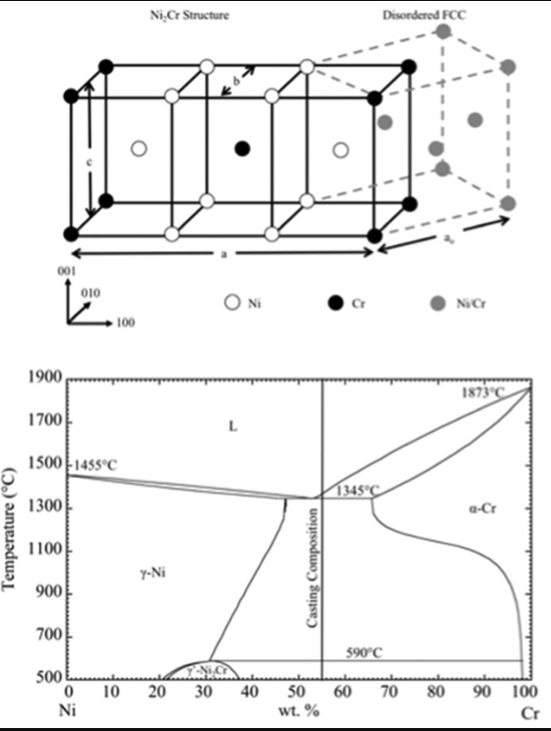
MATERIALS AND SURFACE ENGINEERING
DEPARTMENT OF CIVIL AND MECHANICAL ENGINEERING
PROJECT LEVEL: Master and Bachelor
Short- and Long-range Ordering of Ni-Cr-Fe Alloys
For Nuclear Reactors And Energy Storage Plants
SUPERVISORS
Morten S. Jellesen
msje@dtu.dk,
John Hald
jhald@dtu.dk,
Birgitte Stoffersen
birst@dtu.dk,
[INSERT PROJECT IMAGE]
COLLABORATION
Molten Salt companies as Copenhagen Atomics, Seaborg Technologies or Nordic Salt Cycle
01 / PROJECT BACKGROUND
The focus of this project is an investigation of the short-range ordering (SRO) and long-range ordering (LRO) that can occur in Ni-Cr-Fe alloys. Industry applications such as next-generation salt-moderated nuclear power plants and salt thermal energy storage systems are highly corrosive environments relying on Ni-Cr-Fe alloys for tubes and tanks.
02 / PROJECT AIM
SRO and LRO are phenomena that can occur in Ni-Cr alloys where the nickel and chromium atoms arrange in a non-stoichiometric Ni₂Cr phase. This type of ordering is known to occur after long-time exposure to temperatures between 350-550°C. The ordering can lead to severely decreased mechanical properties by negative creep and promoted planar slip resulting in catastrophic failure of the affected part.
03 / PROJECT ACTIVITIES
The project is experimental but will also require the student to apply knowledge from literature to find a viable solution to the challenges. The experimental part could include:
Heat treatment of relevant Ni-Cr tubes and coupons using furnaces.
Evaluation of the developed ordering and the severity of the ordering.
Characterization of the heat-treated alloys using: LOM, XRD, SEM, EDS, TEM and micro-hardness
04 / PRACTICAL NOTES
The exact topic and nature of the project will be specified in a discussion with the students who are interested.
DTU CONSTRUCT / MATERIALS AND SURFACE ENGINEERING

Slide 3
MATERIALS AND SURFACE ENGINEERING
DEPARTMENT OF CIVIL AND MECHANICAL ENGINEERING
PROJECT LEVEL: Master and Bachelor
Stress Corrosion Cracking (SCC) in Welds
For Nuclear Reactors
SUPERVISORS
Morten S. Jellesen
msje@dtu.dk,
John Hald
jhald@dtu.dk,
Birgitte Stoffersen
birst@dtu.dk,
[INSERT PROJECT IMAGE]
COLLABORATION
Molten Salt companies as Copenhagen Atomics, Seaborg Technologies or Nordic Salt Cycle
01 / PROJECT BACKGROUND
The focus of this project is an investigation of stress corrosion cracking (SCC) in nickel welds and in the heat-affected zone (HAZ) around the welds . Industry applications such as next-generation molten salt-moderated nuclear power plants and molten salt thermal energy storage systems are highly corrosive environments relying on Ni-Cr-Fe alloys for tubes and tanks.
02 / PROJECT AIM
Welded areas are known weak spots where residual stresses can build up leading to SCC. SCC can occur suddenly and without warning leading to a catastrophic failure. The project is highly experimental but will also require the student to apply known knowledge from literature to find a viable solution to the challenges.
03 / PROJECT ACTIVITIES
The experimental part could include:
Corrosion of welded Ni-Cr-Fe tubes and coupons in NaOH.
Developing a heat treatment for the Ni-welds using both furnaces and heat wrapping.
Evaluation of the developed heat treatment and on the necessity of a heat treatment.
Characterization of the welds and the HAZ using; LOM, XRD, SEM, EDS, and micro-hardness.
04 / PRACTICAL NOTES
The exact topic and nature of the project will be specified in a discussion with the students who are interested.
DTU CONSTRUCT / MATERIALS AND SURFACE ENGINEERING

